Slide 1
Operationalized R models: Creating R API services
25 Mar 2019

Slide 2
Basic Setup
Convert R models to API
Operationalized R
Docker Image
Notebooks
API
Apps
API
Model Testing
model.rds
API
plumber
Data Integration
plumber
plumber
train
serve
train
serve
train.R
predict.R
Linux + R Base Image
Linux + R Base Image
entrypoint
EC2 Instance
train
serve
main.R
Dockerfile
RStudio
Docker
AWS

Slide 3

Demo
How to convert R model to API-based docker image using plumber

Slide 4

AWS Deployment Using SageMaker

Slide 5
AWS Deployment Using SageMaker

Slide 6
AWS Deployment Using SageMaker
Suitable for EDC Operationalization Needs
=
R Model
Docker Image

Slide 7
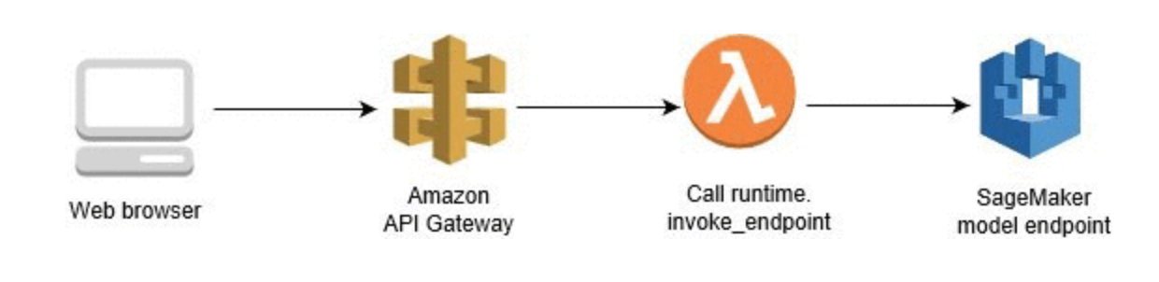
Demo
Using SageMaker to Expose Inference API

Slide 8
Advanced Architecture
R Model

Slide 9
Reference
Code and Slides are available on Github
https://github.com/jafaeldon/r-api-demo

Slide 10

Thank You

